Slide 1
2. Combinational systems
Fondamenti di Elettronica
Sergio Spanò – spano@ing.uniroma2.it

Slide 2
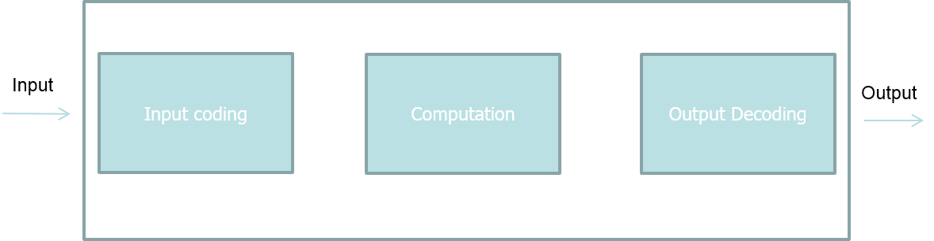
Digital System: generic architecture 1/2
A digital system in composed by
Input Coding
Computation element
Output decoding

Slide 3
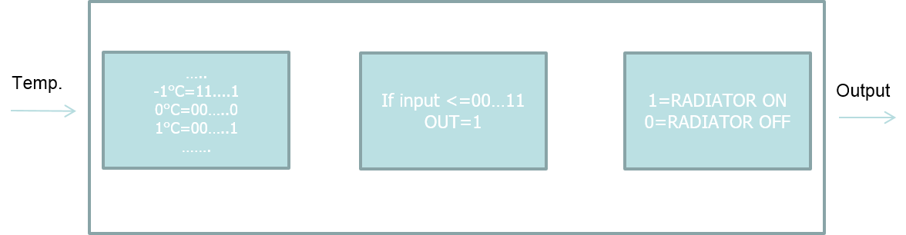
Digital System: generic architecture 2/2
Example: automatic radiator manager
If the temperature is <= 10°C =>Radiator On else Radiator Off

Slide 4
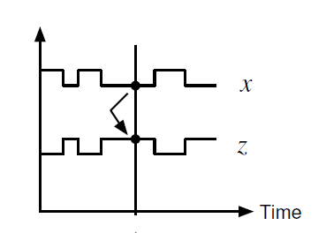
Digital System: combinational system 1/2
In combinational systems the output is function only of the present input
Z(t)=f(X(t))
In other words, the outputs don’t depend on the history of the system.
The system is without memory.

Slide 5
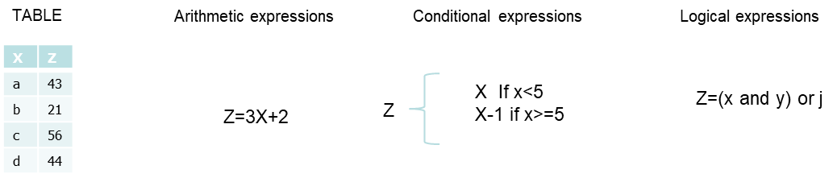
Digital System: combinational system 2/2
Combinational system can be represented using different methods:
Tables
Arithmetic expressions
Conditional expressions
Logical expressions

Slide 6
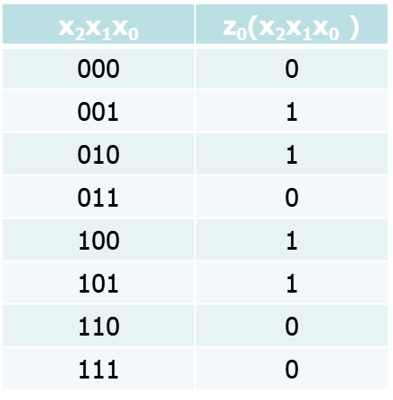
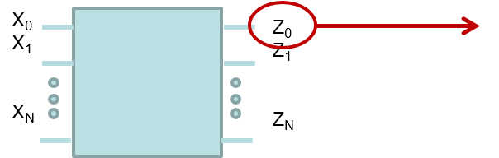
Boolean functions
Combinational system can be implemented using Boolean functions (Switching functions)
A Boolean function is a function which inputs and output can assume only the value 0 or 1

Slide 7
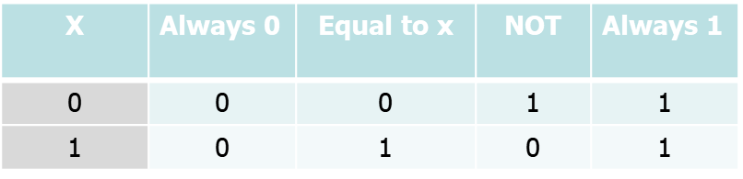
Boolean functions: One input Boolean functions
Four 1 bit Boolean functions can be defined:
Always 0
Equal to x (Buffer)
Not (Inverter)
Always 1

Slide 8
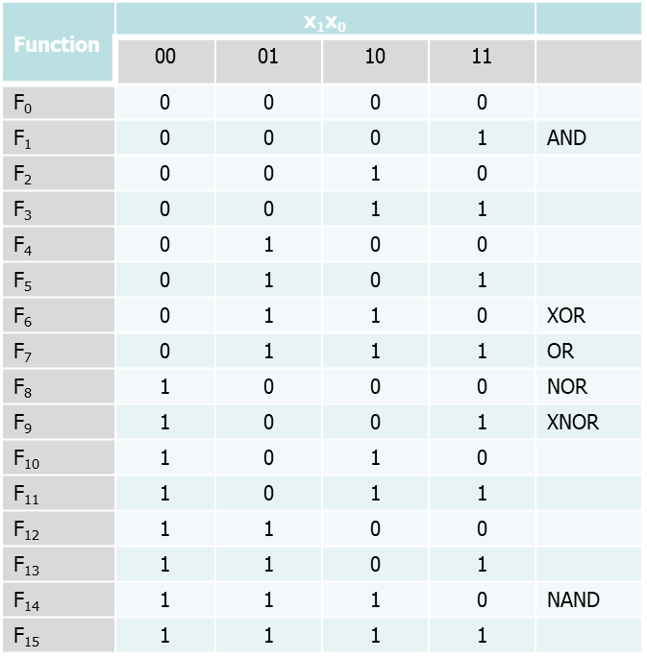
Boolean functions: Two inputs Boolean function
Sixteen 2 bit Boolean functions are defined. Among these, only 6 are frequently used:
And
Xor
Or
Nor
Xnor
Nand

Slide 9
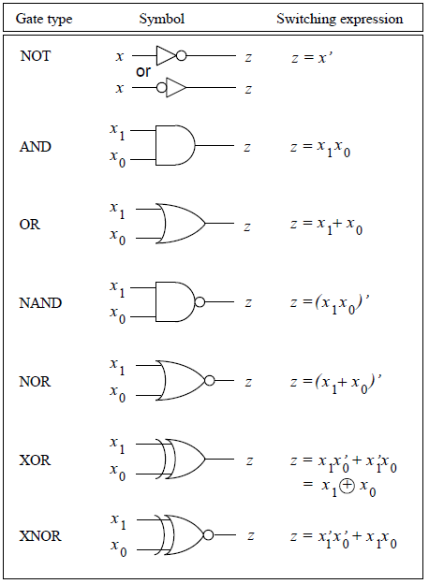
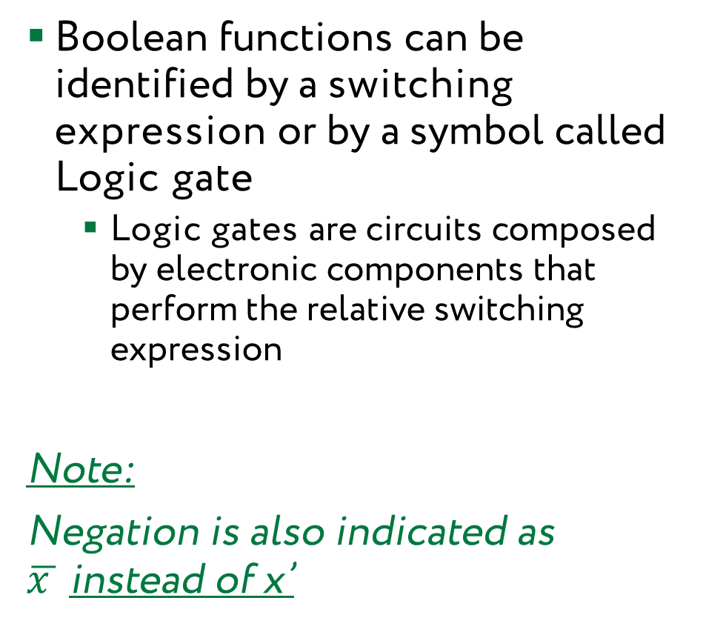
Boolean functions: Logic Gates
Boolean functions can be identified by a switching expression or by a symbol called Logic gate
Logic gates are circuits composed by electronic components that perform the relative switching expression
Note:
Negation is also indicated as $\overline{x }$instead of x’

Slide 10
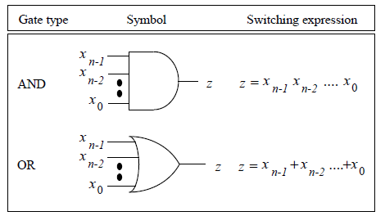
Boolean functions: N inputs Boolean function
Logic gates can be generalized for N inputs
Usually for physical reasons N is limited (about 8)

Slide 11
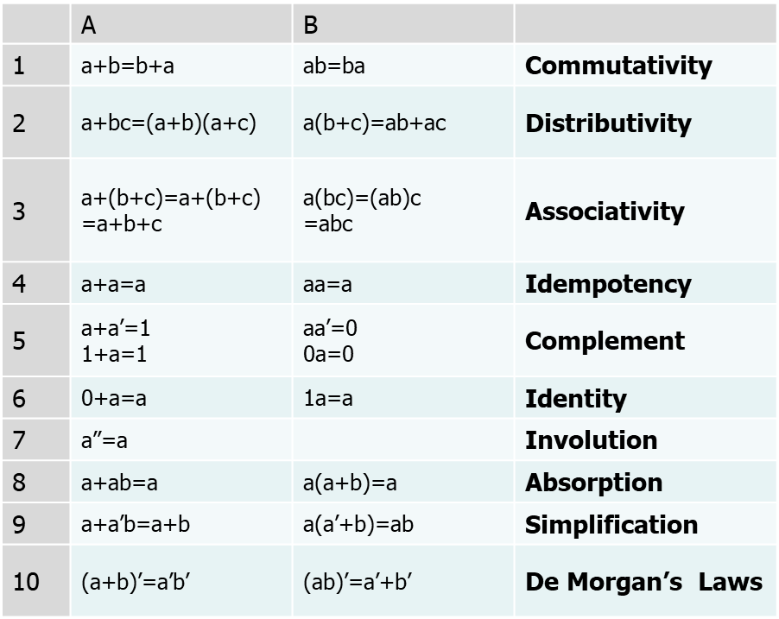
Boolean Algebra
Properties:

Slide 12
Minterms
Literals: A single boolean variable
x, x’, z, y’….
Product terms: product of boolean variables
x, x₀x₁ , x₀x₁’ …
Sum of Products:
x₁+x₀x₁+x₁x₃
Minterm: A minterm of n variables is a product term of n literals containing each variable once in it, both negated or not
Ex n=3 ➔ 8 minterms m₀,m₁..m₇
x₂x₁x₀ x₂’x₁x₀ are minterms
x₂x₁ x₀x₂ are not minterms

Slide 13
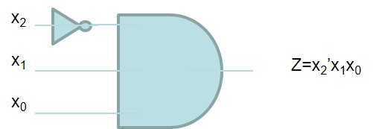
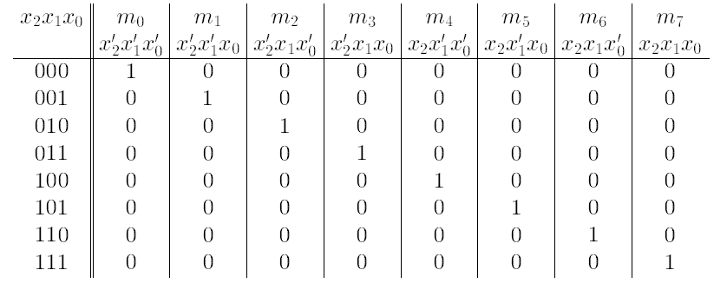
Minterms: m-notation
Each minterm has a 1 value only for one assignment of the variables
Ex m₃ ➔1 if x₂’x₁x₀ =011

Slide 14
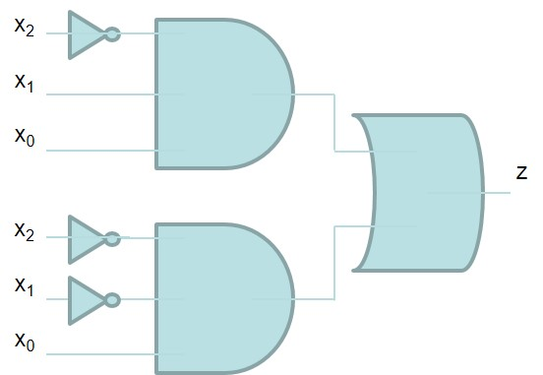
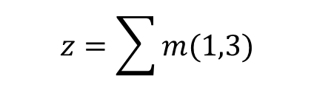
Minterms: sum of minterms
A sum of minterms contains only not repeated minterms
$$z=\sum{m(1,3)}$$

Slide 15
Maxterm
Sum terms: sum of boolean variables
x, x₀+x₁ , x₀+x₁’ …
Products of Sum :
(x₁+x₀+x₁)(x₁+x₃)
Maxterm: A maxterm of n variables is a sum of n literals containing each variable once, both negated or not negated
Ex n=3 ➔ 8 maxterms M₀,M₁..M₇
(x₂+x₁+x₀) (x₂₊x₁₊x₀) are maxterms
(x₂+x₁) (x₀+x₂) are not maxterms

Slide 16
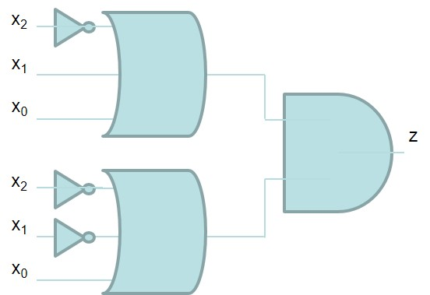

Maxterms: product of maxterms
Also Mamxterms have an M-notation, so M₃ ➔0 if x₂’+x₁+x₀ =100 (complement of minterm)
A product of Maxterms contains only not repeated Maxterms
$$z=\prod{M(4,6)}$$

Slide 17
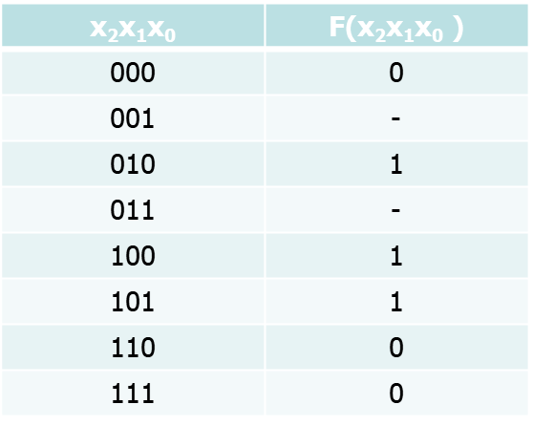


Terms and Switching functions
Functions can be represented using Minterms or Maxterms
If a function is incomplete, it is possible to use the don’t care (-)
$$F=\sum{m(2,4,5)}$$
$$F=\prod{M(0,6,7)}$$
or

Slide 18
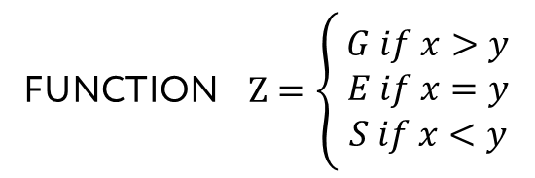

Design example 1/5
Design a digital comparator
G=GREATER
E=EQUAL
S=SMALLER
$x,y∈\left\{0,1,2,3\right\}$ $z∈\left\{G,E,S\right\}$
FUNCTION $Z=\left\{\begin{aligned}G if x>y \\ E if x=y \\ S if x<y\end{aligned}\right.$

Slide 19
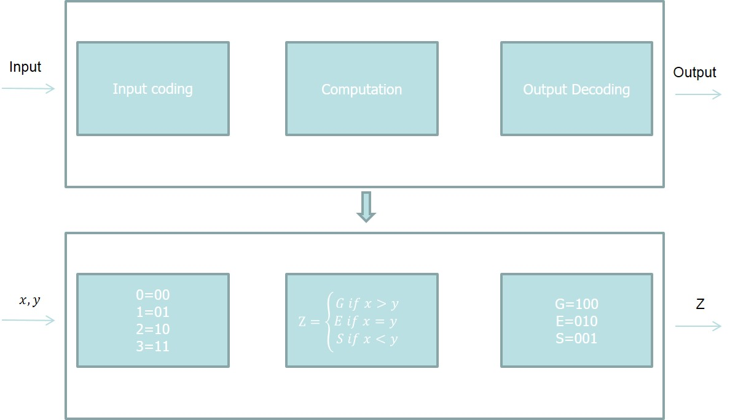
Design example 2/5

Slide 20
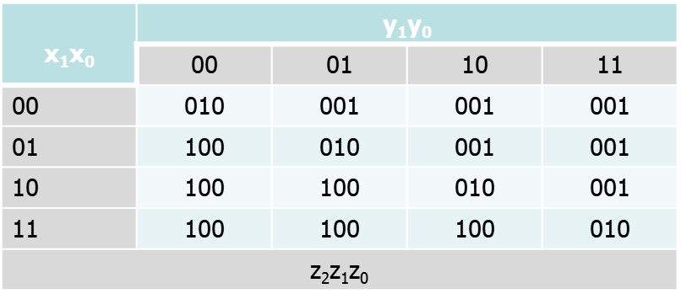
Design example 3/5

Slide 21
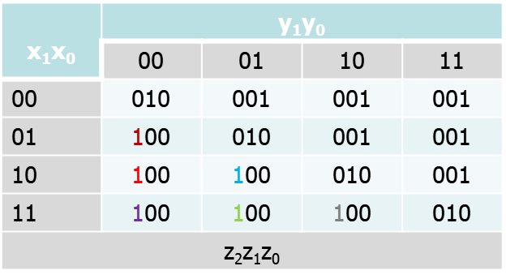
Design example 4/5
Z₂ =X₁’X₀Y₁’Y₀’+X₁X₀’Y₁’Y₀’+X₁X₀Y₁’Y₀’+ X₁X₀’Y₁’Y₀ + X₁X₀Y₁’Y₀+X₁X₀Y₁Y₀’
Z₁=…….
Z₀=…….

Slide 22
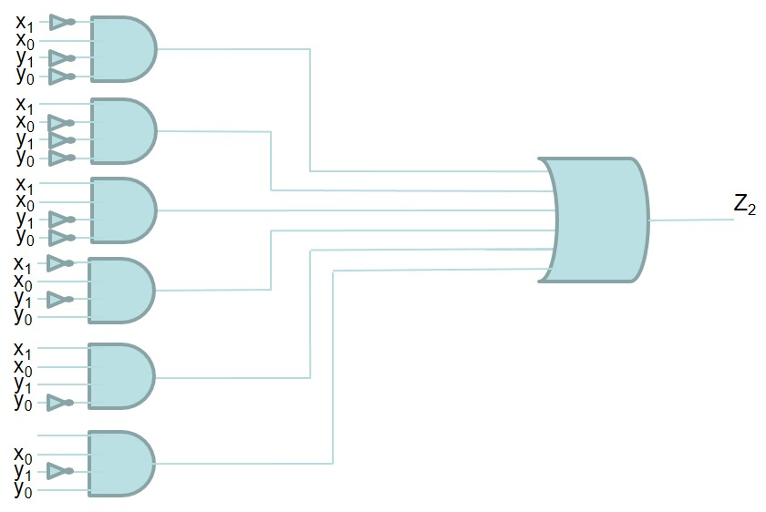
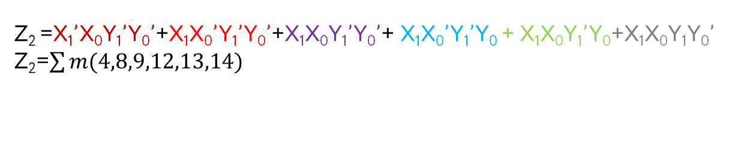
Design example 5/5
Z₂ =X₁’X₀Y₁’Y₀’+X₁X₀’Y₁’Y₀’+X₁X₀Y₁’Y₀’+ X₁X₀’Y₁’Y₀ + X₁X₀Y₁’Y₀+X₁X₀Y₁Y₀’
Z₂=$\sum{m(4,8,9,12,13,14)}$

